Slide 1
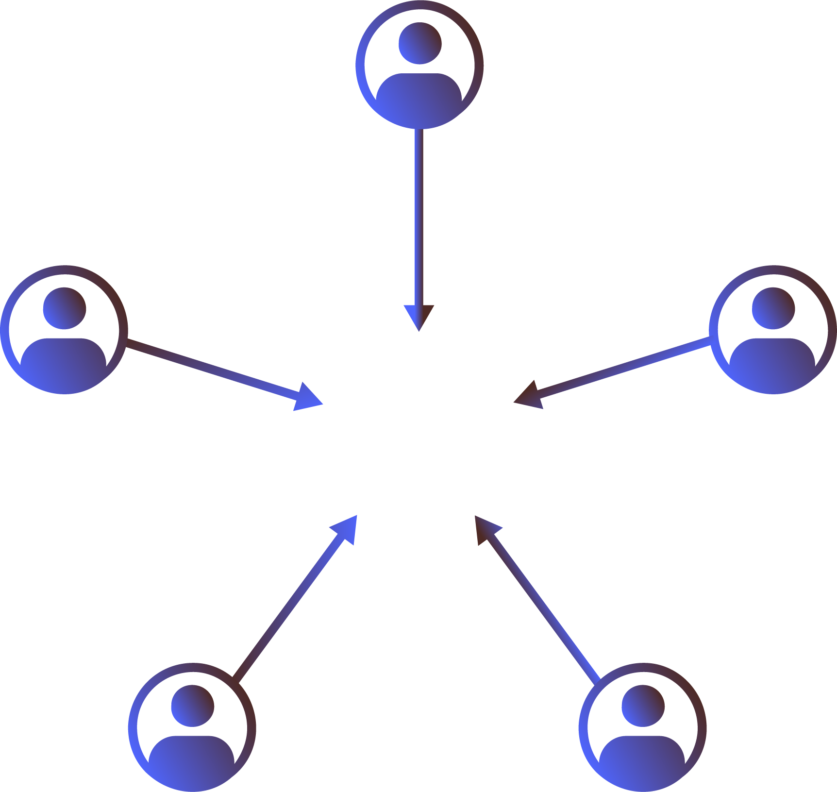


I’m Learning
15 minute investment
How to guides
Best practices
Project checklists
OK Lead
I’m Planning,
Visualizing & Pricing
I’m Getting Ideas
60+ minute investment
15 minute investment
3D room planner
Virtual design help
HD room renders
Contact Design Services
Inspirational photos
Product guides
Before & after gallery
Best Lead
Good Lead
I’m Narrowing
My Style & Choices
Great Lead
Better Lead
I’m Budgeting
30 minute investment
30 minute investment
Visualizers
Product configurators
Before & after gallery
Project survey
Pricing guide
Project calculators
©2022 3D Cloud™ by Marxent

